Slide 1
Tensorflow vs Torch
Mengji He
Golnoosh T.
Arip Nur

Slide 2
MNIST datasets
Downloaded from : https://www.kaggle.com/datasets/hojjatk/mnist-dataset

Slide 3
Model’s structure
Tensorflow
Pytorch
model = tf.keras.models.Sequential([
tf.keras.layers.Flatten
(input_shape=(28, 28)), tf.keras.layers.Dense(128,
activation='relu'), tf.keras.layers.Dropout(0.2),
tf.keras.layers.Dense(10)])
nn.Sequential(nn.Linear(28*28, 128), nn.ReLU(),
nn.Linear(128, 128),
nn.ReLU(),
nn.Linear(128, 10))

Slide 4
Model’s structure
Tensorflow
Pytorch
loss_fn = tf.keras.losses.SparseCategoricalCrossentropyOptimizer: tf.keras.optimizers.Adam()
Loss_fn = nn.CrossEntropyLoss()
Optimizer: torch.optim.Adam()
Epoch number | 300
Batch size | 64

Slide 5
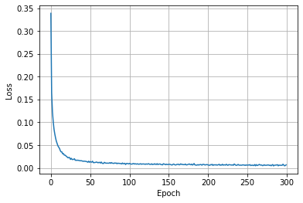
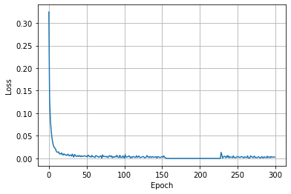
Fitting the model
Tensorflow
Pytorch
Epoch: 300
Loss: 0.0068
Accuracy: 99.79%
Total training time: 625.62s
Epoch: 300
Loss: 0.4559
Accuracy: 98.10%
Total training time: 4371.84s
s

Slide 6
Drought Datasets

Slide 7
Model’s structure
Tensorflow
Pytorch
Container: tf.keras.Sequential
First layer: tf.keras.layers.Dense(64)
Activation function: tf.keras.layers.Activation('relu')
Second layer: tf.keras.layers.Dense(1)
Container: nn.Sequential
First layer: nn.Linear
(in_features=4, out_features=64)
Activation function: nn.ReLU()
Second layer: nn.Linear
(in_features=64, out_features=1)

Slide 8
Model’s structure
Tensorflow
Pytorch
Loss function: tf.keras.losses.MeanSquaredError()
Optimizer: tf.keras.optimizers.Adam()
Loss function: nn.MSELoss()
Optimizer: torch.optim.Adam()
Learning rate | 0.001
Epoch number | 300
Batch size | 64

Slide 9
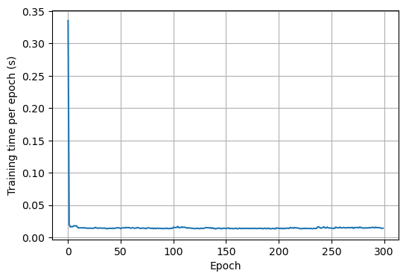
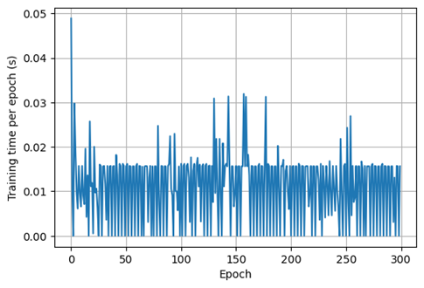
Training Time
Tensorflow
Pytorch
Total training time: 4.6307s
Average of each epoch : 0.0154s
Total training time: 3.3624s
Average of each epoch : 0.0112s

Slide 10
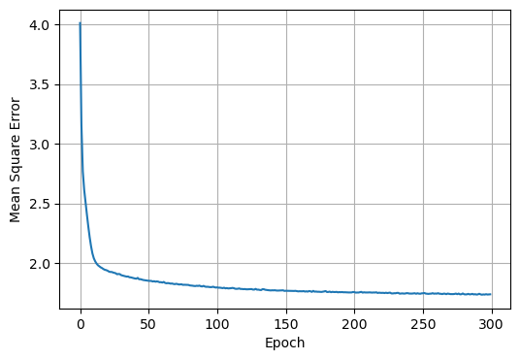
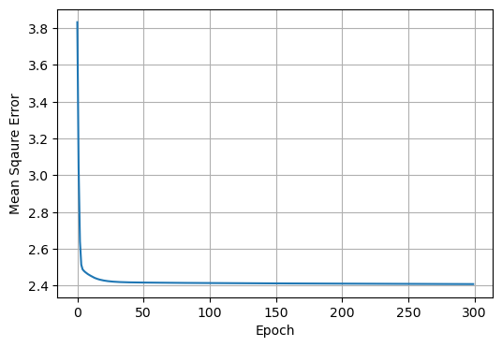
Mean Square Error (epoch=300)
Tensorflow
Pytorch
Training set at final epoch=1.7371
Test set = 1.6751
Training set at final epoch=2.4081
Test set = 2.5907

Slide 11
Ease of Use
Tensorflow
Pytorch
Don’t need to convert data type
Has model.fit function to train the model
Easier and faster to build and train a model with keras. The code is shorter than that of PyTorch, suitable for beginners.
Need to convert numpy ndarray and pandas dataframe type to torch tensor type
Write function or for loop to train the model
PyTorch code covers many details, resulting in longer code and more flexible.

Slide 12
Pairwise comparison of each criteria
 | Accuracy (c1) | Training time (c2) | Complexity (c3) | Loss (c4)
Accuracy (c1) | 1 | 7 | 9 | 3
Time processing (c2) |  | 1 | 1/3 | 1/5
Complexity (c3) |  |  | 1 | 1/5
Loss (c4) |  |  |  | 1
 | Accuracy (%) | Training time (s) | Complexity (1-10) | Loss
Tensorflow | 98.14 | 625.62 | 4 | 0.2141
Pytorch | 97.97 | 4371.84 | 8 | 0.4559

Slide 13


Results
Alternatives | Score | Rank
Tensorflow | 1 | 1
Pytorch | 0 | 2

Slide 14
References
https://www.tensorflow.org/tutorials
https://pytorch.org/tutorials/
https://www.kaggle.com/datasets/hojjatk/mnist-dataset

Slide 15
Thank you

